Slide 1
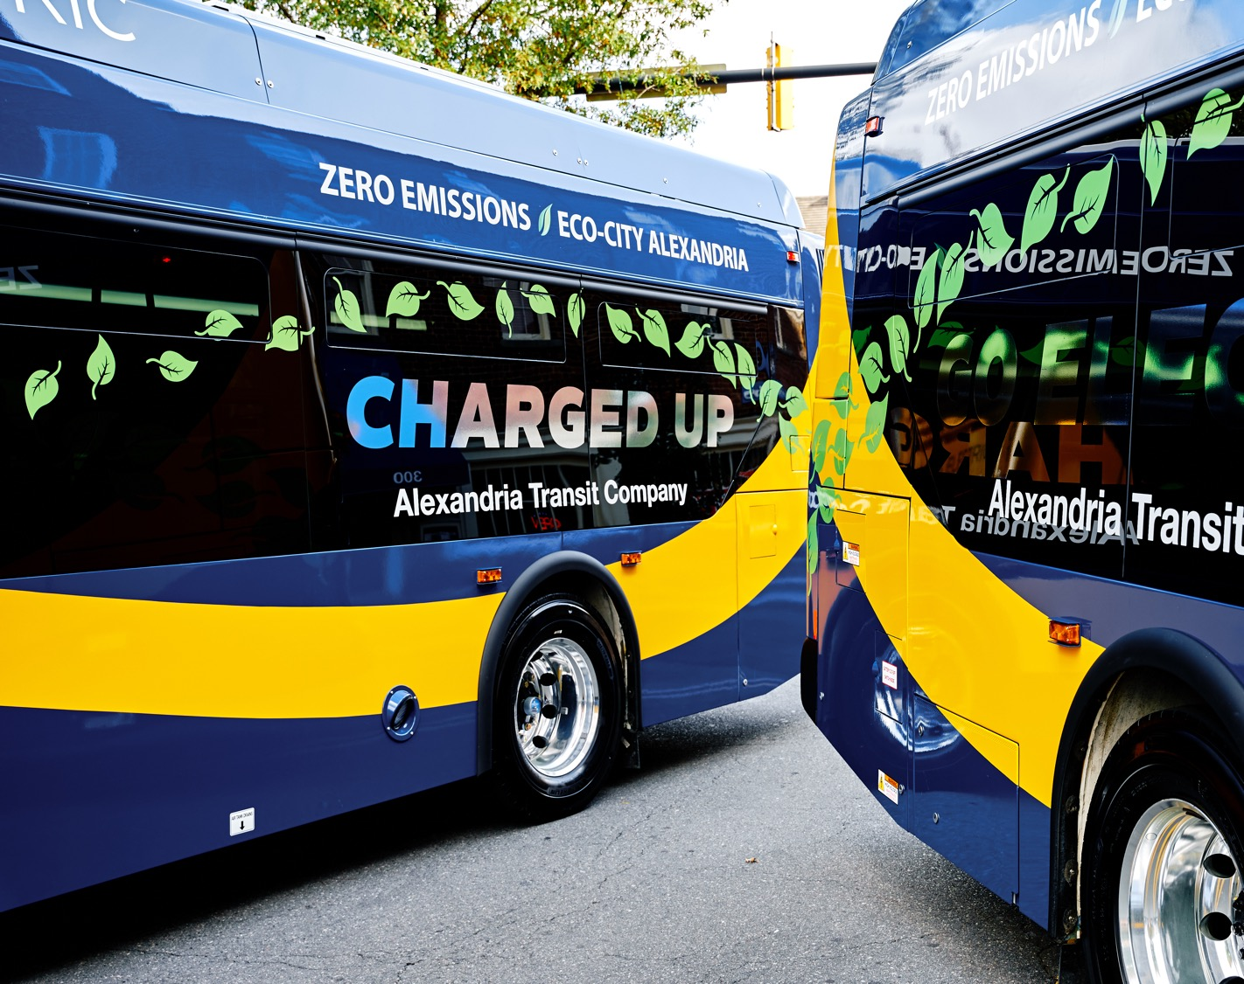
Meeting will begin soon
Alexandria transit company
Board of directors meeting
November 09, 2022

Slide 2
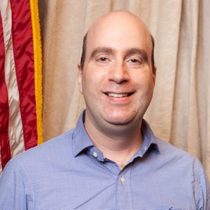
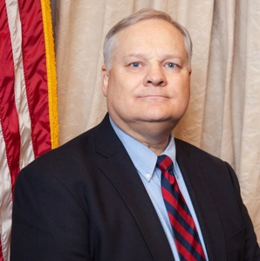
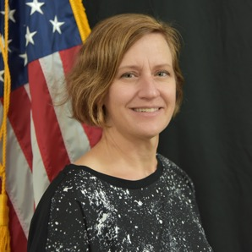
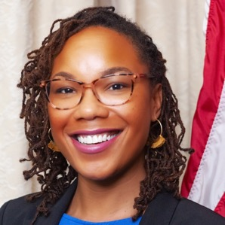
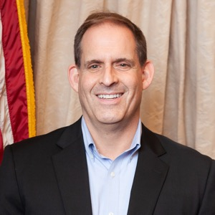
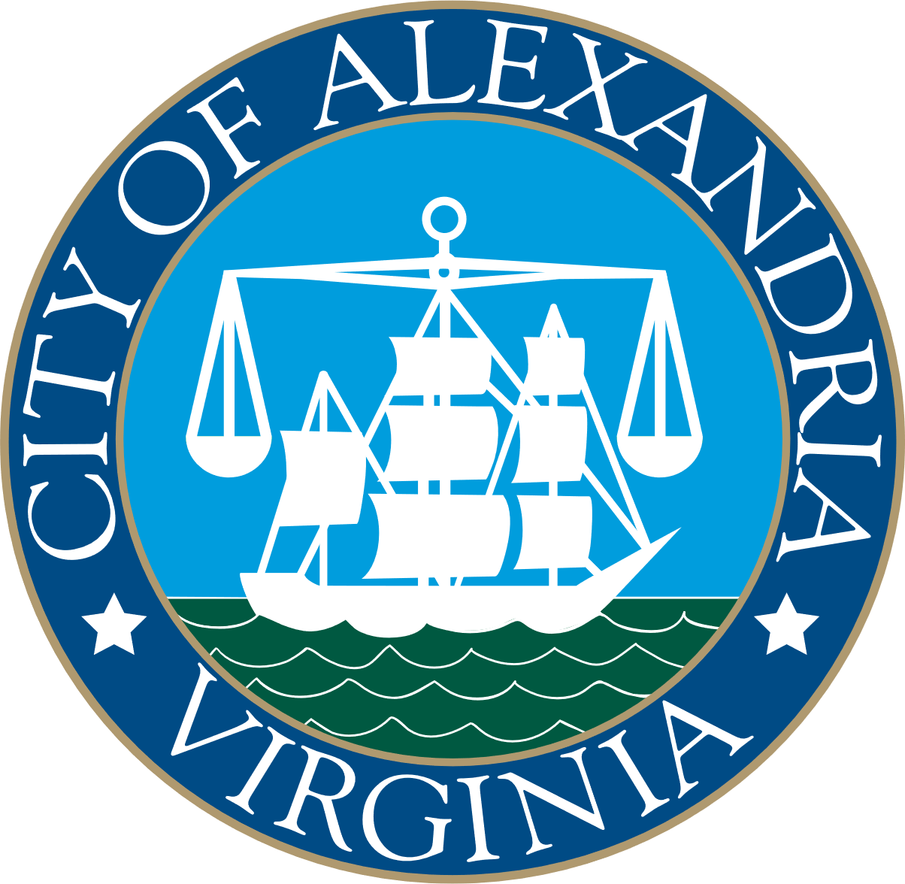
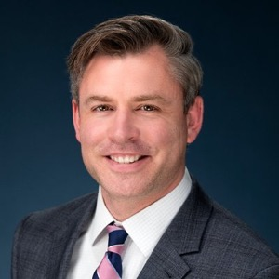
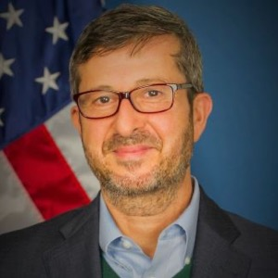
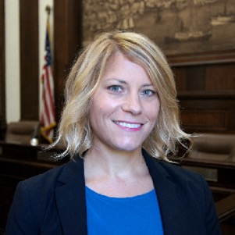
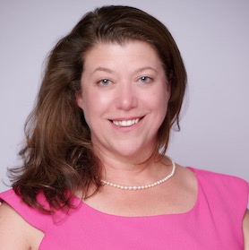
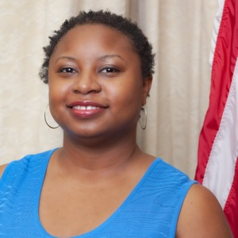
Calling of the rolL
David Kaplan
Steve Klejst
Linda Bailey
Brandi Collins
Matt Harris
Chair of the Board
Vice-Chair of the Board
Jesse O’Connell
Murat Omay
Hillary Orr
Kendel Taylor
Ajashu Thomas
Agenda Item: N/A
Board Packet Page: N/A
Board Action: None

Slide 3

Public Comment period
Those wishing to speak during Hearing may pre-register at dashbus.com/ and join via Zoom.
Alternatively, attendees may use the “RAISE HAND” feature to be recognized for comment.
Agenda Item: N/A
Board Packet Page: N/A
Board Action: FYI

Slide 4
Public Comment period
Each speaker is permitted 3 minutes for public comment.
When the YELLOW light appears, 1 minute remains.
When the RED light appears, you are out of time.
Time Has Expired
Wrap Up
Speak Now
Agenda Item: N/A
Board Packet Page: N/A
Board Action: FYI

Slide 5
Approval of minutes
Consideration of approval of Meeting Minutes from the October 12, 2022 meeting of the Alexandria Transit Company Board of Directors.
Agenda Item: 2
Board Packet Page: 2-6
Board Action: Approval

Slide 6
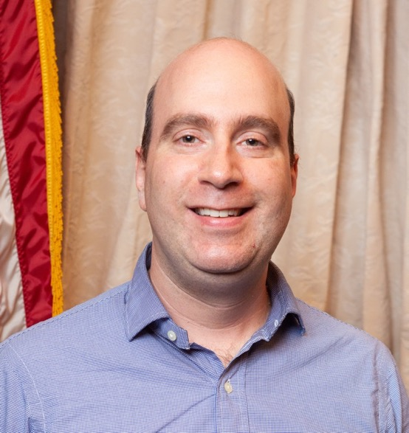
Chair’s report
Chairs Report
Public Speaker Policy
David Kaplan
Chair of the Board
Agenda Item: 3a
Board Packet Page: 7-9
Board Action: Consider Approval

Slide 7
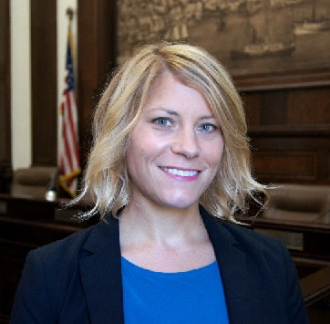
T&ES Report
Hillary Orr
Deputy Director
T&ES – City of Alexandria
Agenda Item: 3b
Board Packet Page: 7-9
Board Action: Discussion

Slide 8
T&ES Report
Duke Street in Motion
The City hosted four public meetings in October and ten pop-up events to provide information on the Duke Street Transitway project and solicit feedback. Staff presented multiple design options for each segment of Duke Street, highlighting impacts and tradeoff for each. On November 17th, the Duke Street Advisory Group will meet to go over the community feedback and begin discussions about narrowing down options for more detailed analysis.
Rail Projects
City staff has been working with the Virginia Passenger Rail Authority (VPRA) staff to coordinate on upcoming projects in Alexandria. Updated information will be posted on the City’s Rail Projects and Partners website: https://www.alexandriava.gov/transportation-planning/rail-projects-and-partners
    Alexandria Fourth Track
    King and Commonwealth Rail Bridges
VPRA held a virtual public meeting on November 2 to discuss this project with the community and will be presenting at the Transportation Commission on November 16. They are recommending a design option and soliciting public input via a comment survey open through December 2, 2022. Construction would begin in spring 2024.
Agenda Item: 3b
Board Packet Page: 7-9
Board Action: Discussion

Slide 9
T&ES Report
Metro
Potomac Yard Metrorail Station: The first test train went through the new Potomac Yard Metrorail station last month. This is a major milestone for WMATA, but the opening date is still “sometime in 2023.” WMATA has promised an update in December.
Silver Line Opening: WMATA has announced an opening date of November 15, 2022, for the Silver Line extension.
FY24 Budget: Metro discussed their $146 million budget gap in October. Efforts to further reduce the budget could include service reductions, fare increase and a transfer of preventative maintenance from the operation to the capital budget, which has additional funding from the Infrastructure Investment and Jobs Act (IIJA).
Agenda Item: 3b
Board Packet Page: 7-9
Board Action: Discussion

Slide 10

Other Board Member Reports and Updates
Agenda Item: 3c
Board Packet Page: N/A
Board Action: FYI

Slide 11
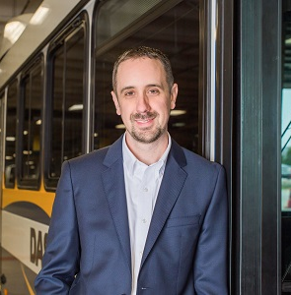
General managers reports
Staff Announcement
Bradlee Shopping Center
Josh Baker
General Manager & CEO
Agenda Item: 4a, 4b, 4c, 4d
Board Packet Page: 10-16
Board Action: Approval

Slide 12
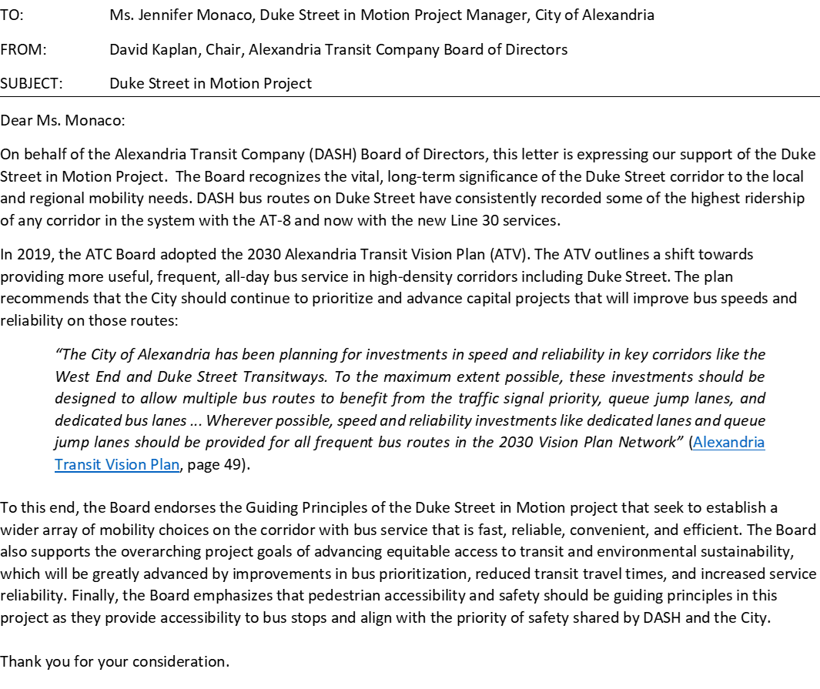
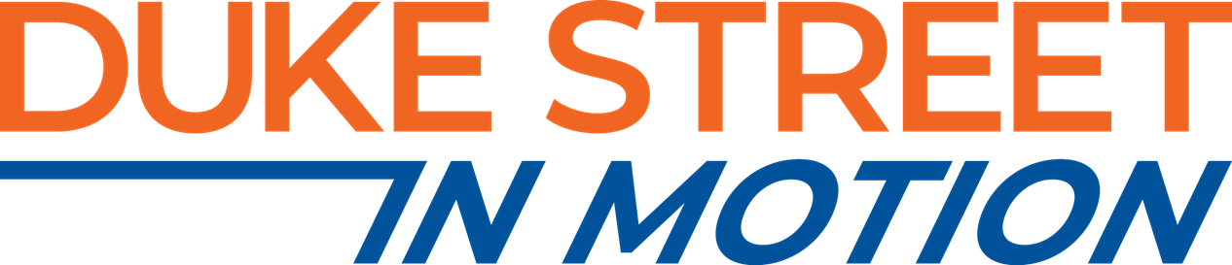
General managers reports
Duke Street in Motion Letter
In response to Board guidance from October, 2022, staff have generated a Duke Street In Motion support letter for consideration of approval. The letter is included in the Board Packet on Page 11.
Agenda Item: 4a, 4b, 4c, 4d
Board Packet Page: 10-16
Board Action: Approval

Slide 13
General managers reports
2024 Current Services Budget
The FY 2024 General Manager’s Proposed Operating Budget increases by $3,558,260 (12.5%) to a total of $31,941,842. This budget is constrained and addresses only mandatory step increases, escalating costs of operation (i.e. Fuel, Parts, etc.), and addresses line items for inflation. FY24 is the first full year of the improved service along Line 30, which was implemented in Q2 of FY23. In addition to cost increases, funding through the Virginia TRIP grant will decrease again in accordance with our grant agreement. Finally, advertising revenue projections are reduced due to continued underperforming interest in purchasing ads.
Key Assumptions
Regular Compensation Increases [Cost Increase: $1,901,074]
Fuel Cost Increases [Cost Increase: $1,157,648]
TRIP Funding Grant Reduction: [Decreased Revenue: ($1,047,067)]
Maintenance Parts and Service [Cost Increase: $167,740]
Local Grant Match Increase [Cost Increase: $105,000]
Advertising Program Underperformance Reduction [Decreased Revenue: ($86,400)]
Agenda Item: 4a, 4b, 4c, 4d
Board Packet Page: 10-16
Board Action: Approval

Slide 14
General managers reports
2024 Current Services Budget Overview
Agenda Item: 4a, 4b, 4c, 4d
Board Packet Page: 10-16
Board Action: Approval

Slide 15
General managers reports
2023 vs 2024 Current Services Comparison
This table analyzes all changes from the FY23 to the F24 operating budget, categorized by initiative, cost driver, or revenue source.
Agenda Item: 4a, 4b, 4c, 4d
Board Packet Page: 10-16
Board Action: Approval

Slide 16
General managers reports
Budget Comparison
Presented a means of benchmarking, as done in prior budget cycles, the table below analyzes DASH and Metrobus budgeted operating costs per platform hour. The term “platform hour” refers to all hours for which buses are in service, which is the most relevant measure of true cost.
Given Metrobus’ vastly larger size and complexity, a higher operating cost rate per hour is to be expected. Nevertheless, this budget maintains DASH’s relative cost efficiency vs. Metrobus service.
[Source: WMATA FY23 Approved Operating Budget, p. 37 (budget) p. 294 (platform hours)]
Agenda Item: 4a, 4b, 4c, 4d
Board Packet Page: 10-16
Board Action: Approval

Slide 17
General managers reports
FY 2024 Proposed Supplementals
DASH has reviewed its service and organizational needs for the upcoming fiscal year and prepared the following list of supplemental funding priorities. The supplemental requests have been slightly revised versus the budget priority letter presented to the Board earlier this year. These revisions were made to correct for and reflect the importance of providing more useful weekend bus connections to the new Potomac Yard Metro Station.
Important Note: the General Manager’s recommendation is to prioritize avoiding reductions as the top priority. The City has requested a 2% reduction which equates to ($535,925). These are being prepared by staff and will be presented to the Board at the next meeting, if not addressed prior. The General Manager’s guidance to staff is to identify approximately 1% of reductions as Administrative cuts and approximately 1% of reductions as Service cuts.
Early messaging from the City Manager and City’s OMB staff have stated we are to assume these cuts will be taken.
The City transmitted reduction targets to DASH after the packet for this Board meeting was completed and publicized. They have asked that reductions be submitted on or before November 28th, 2022. This is an issue for discussion by the ATC Board.
Agenda Item: 4a, 4b, 4c, 4d
Board Packet Page: 10-16
Board Action: Approval

Slide 18
General managers reports
FY 2024 Proposed Supplementals
Supplemental # 1 – Alexandria Transit Vision Plan Line 33: $120,000.
DASH is requesting funding to operate additional service along Line 33 to provide improved Sunday service and enhanced connectivity to the new Potomac Yard Metro Station. This request enhances service to every 30 minutes instead of every 60 minutes on Sundays along line 33.
Supplemental # 2 - Alexandria Transit Vision Plan Line 34: $120,000.
As with line 33, DASH is requesting funding to operate additional service along Line 34 to provide improved Sunday service and enhanced connectivity to the new Potomac Yard Metro Station. This request enhances service to every 30 minutes instead of every 60 minutes on Sundays.
Supplemental # 3 -Enhanced Service on Line 31: $880,000.
This proposed improvement increases off-peak and weekend trips by enhancing Line 31 to run every 15 minutes or better, all-day, seven days per week and greatly improve the east-west connectivity between the West End, King Street Metro, and Old Town.
Supplemental # 4 -Enhanced Service on Line 32: $490,000.
DASH is requesting funding to expand service along Line 32 to include improved midday, evening, and weekend service along Line 32. This improvement would bring service from every 60 minutes during those times to every 30 minutes, leading to shorter wait times for buses along Eisenhower Avenue.
Agenda Item: 4a, 4b, 4c, 4d
Board Packet Page: 10-16
Board Action: Approval

Slide 19
General managers reports
FY 2024 Proposed Supplementals
Supplemental #1
Supplemental #2
Supplemental #3
Supplemental #4
Agenda Item: 4a, 4b, 4c, 4d
Board Packet Page: 10-16
Board Action: Approval

Slide 20
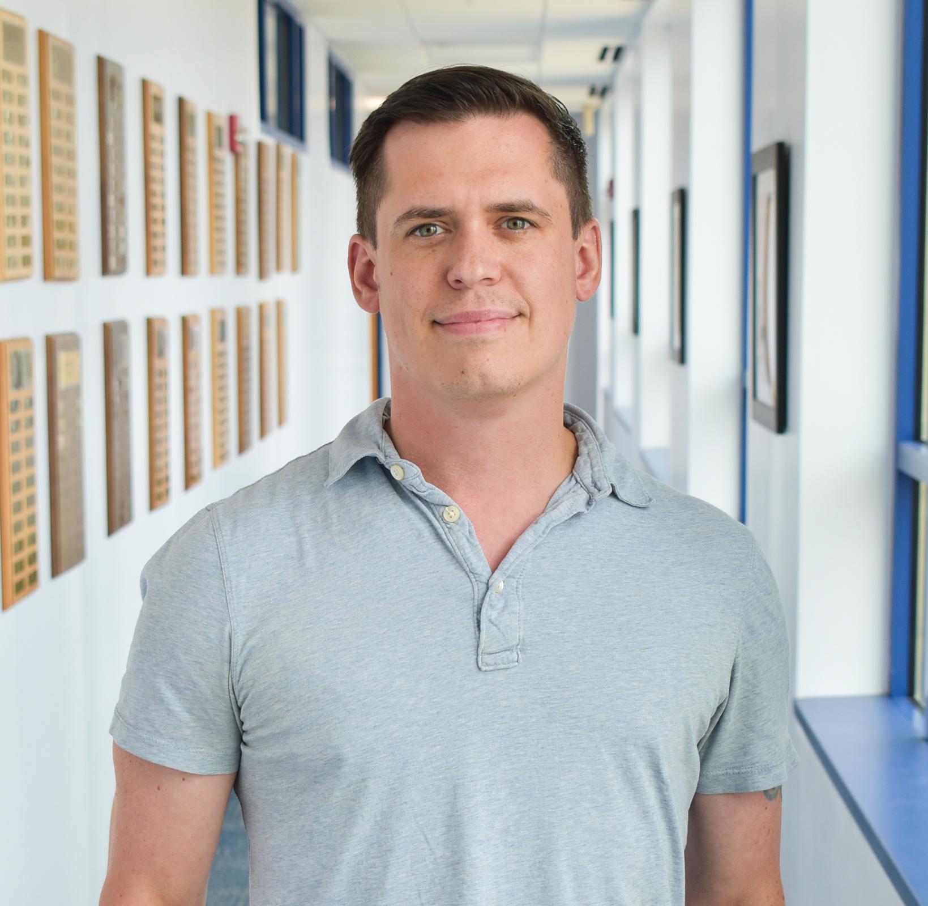
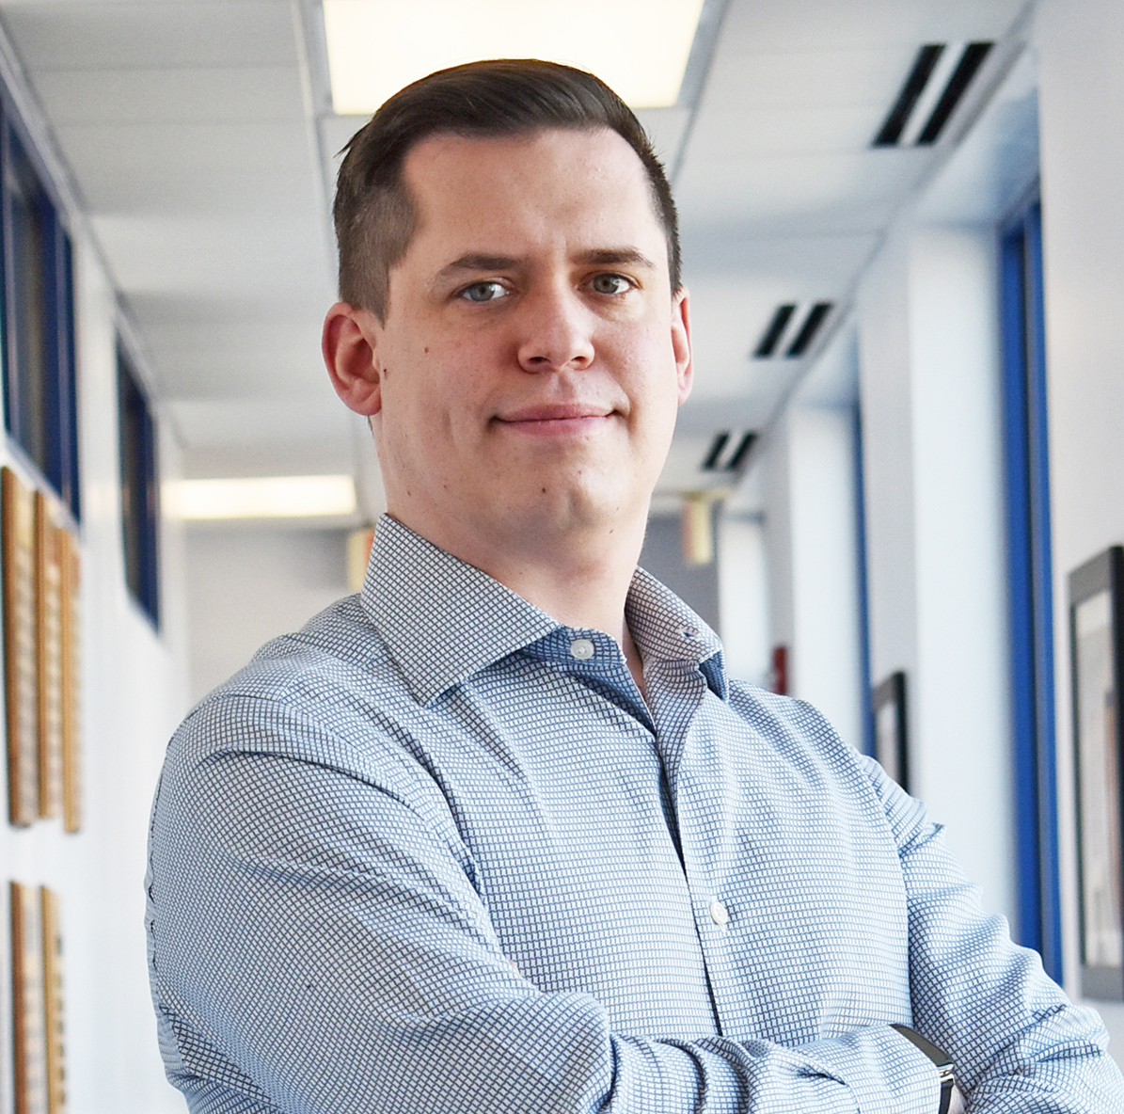
Finance reports and updates
Edward Ryder
Director of Finance
Agenda Item: 5a, 5b, 5c, 5d
Board Packet Page: 17-20
Board Action: Discussion

Slide 21
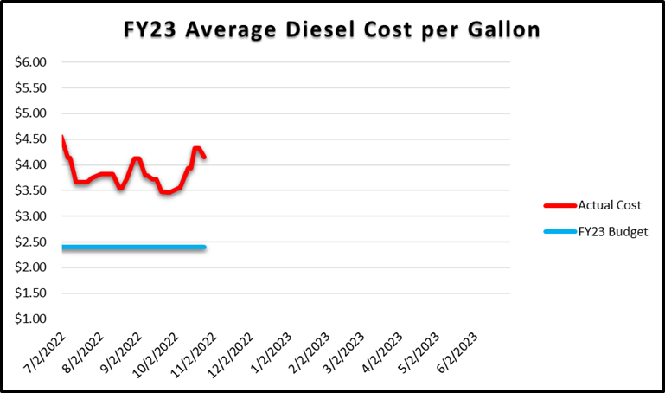
FY 2023 Finance reports
September
Experienced a Year-to-Date Surplus of $1,583, with a projected year end Deficit of ($726,633)
Fuel & Lubricants constitute the largest budgetary pressure for FY2023. Recent diesel costs have been $4.35 per gallon against a budget target of $2.40 per gallon. Current projections suggest DASH will exceed the fuel budget by ($938,010).
Agenda Item: 5a, 5b, 5c, 5d
Board Packet Page: 17-20
Board Action: Discussion

Slide 22
FY 2023 Finance reports
September 2022
Operations Overtime remains an ongoing challenge. CBA requirements regarding seniority-based preferential overtime further compounds the issue.
Building Maintenance includes cash expenditures for projects with a carryover budget from FY22.
Maintenance Repair Parts & Supplies have experienced inflationary price pressures, especially related to tires. Tire prices, for example, are correlated to the cost of crude oil.
Agenda Item: 5a, 5b, 5c, 5d
Board Packet Page: 17-20
Board Action: Discussion

Slide 23
FY 2023 Projections
Agenda Item: 5a, 5b, 5c, 5d
Board Packet Page: 17-20
Board Action: Discussion

Slide 24
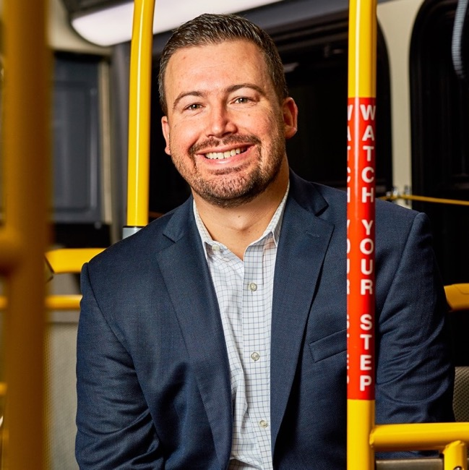
Planning Department reports and Updates
Martin Barna
Director of Planning & Marketing
Agenda Item: 6a, 6b
Board Packet Page: 21-25
Board Action: FYI

Slide 25
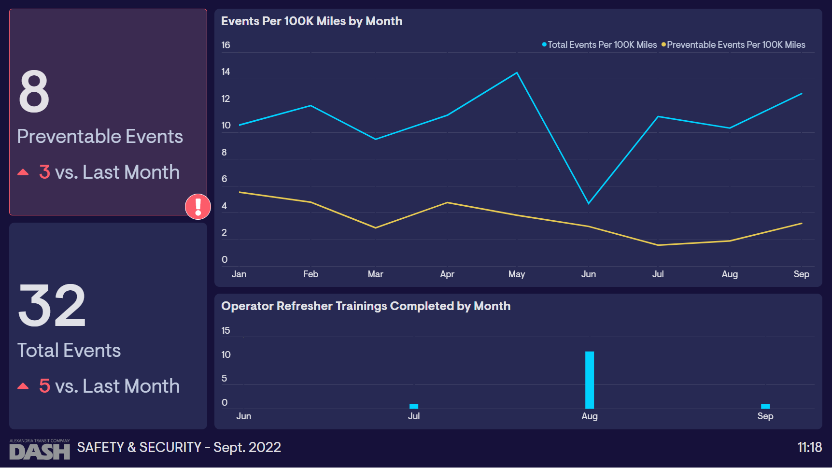
KPI DASHBOARDS
(1) Events. Events include collisions, passenger incidents, property damage, employee injuries, and other safety-related incidents.
(2) Preventable Events. “Preventable” Events are any events that the DASH Safety Review Committee determines could have been prevented by operator actions. The current target is seven (7) preventable events per month or less.
(3) Refresher Trainings. Staff from the DASH Safety team conduct trainings with bus operators to reinforce safety best practices to ensure that all operators are doing everything they can to stay safe. Due to recent staff changes, the number of trainings has been atypically low, but recent hires have allowed regular refresher trainings to resume.

Slide 26
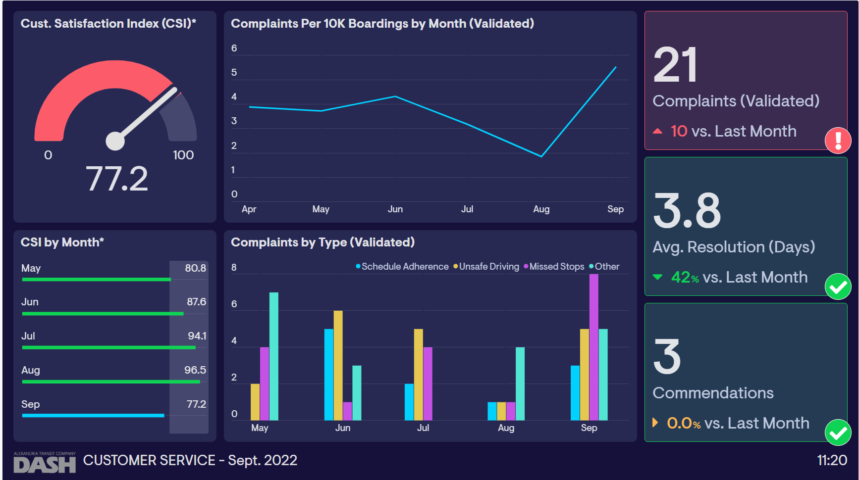
KPI DASHBOARDS
Customer Satisfaction Index (CSI). This index quantifies the number of customer calls, complaints and commendations that are received each month into a single metric that can be tracked over time. The index assigns weighted values for each complaint (negative) and commendation (positive) that are received each month, however, since commendations are relatively uncommon in the transit industry, commendations are weighted 20% more than complaints. The higher the CSI value, the higher the customer satisfaction. The typical range for CSI is 80-95, so months with a CSI below 80 would be cause for concern. Months with a CSI value of 95+ would be indicative of exceptional customer satisfaction for that month.

Slide 27
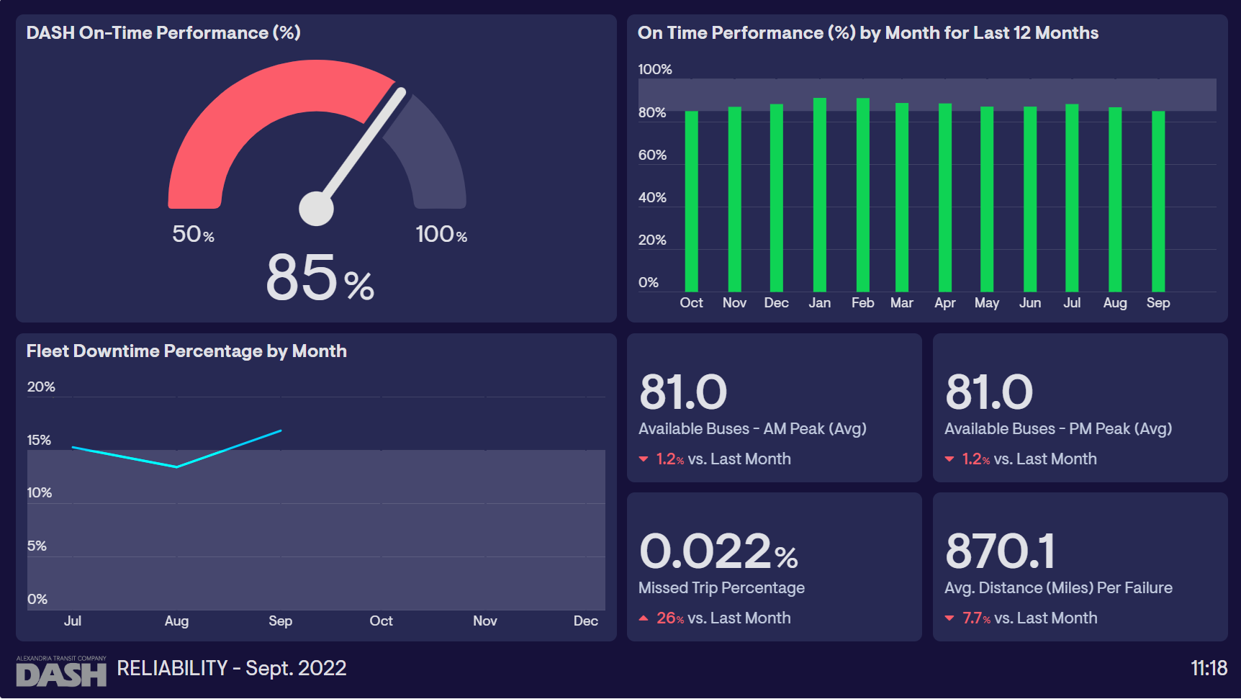
KPI DASHBOARDS
“On-Time Performance” tracks the percentage of scheduled departure times in which the bus departs the stop no more than 1 minute early and no more than 5 minutes late. The current DASH OTP target is 85% of all trips.
“Fleet Downtime” measures the total hours that DASH buses have spent on the “deadline” in a given month, divided by the total number of hours in that month. This is a new metric that does not currently have an industry standard.
“Available Buses” are the average number of buses that were available to be put into revenue service during weekday peak periods in each month.
“Missed Trips” are trips that are not provided due to mechanical breakdowns, driver error, or staffing shortages. “Average Distance between Failure” measures how often the buses are breaking down due to mechanical issues.

Slide 28
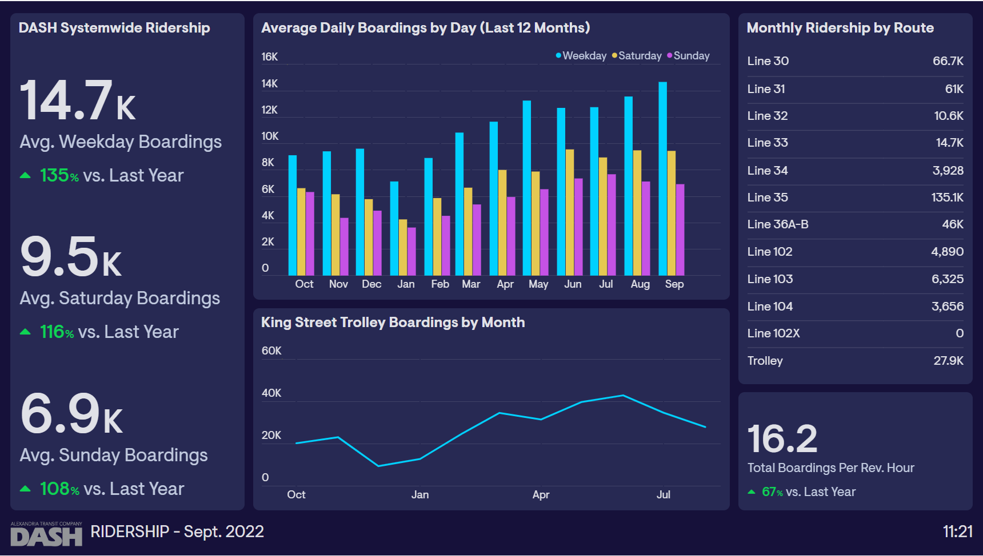
KPI DASHBOARDS
“Boardings” are the number of times a passenger boards a bus. A passenger making a round-trip would count as two boardings.
“Boardings Per Revenue Hour” are calculated as the total boardings divided by total number of revenue hours of service that were provided. This metric is designed to normalize the number of boardings against the amount of service that is operated as a means of measuring service efficiency or productivity.
The contract with the Department of Defense for Line 102X (Mark Center Express) was suspended until further notice in December 2021.

Slide 29
Ridership updates
New Network & Free Fares
Omicron Variant Surge
Agenda Item: 6a, 6b
Board Packet Page: 21-25
Board Action: FYI

Slide 30

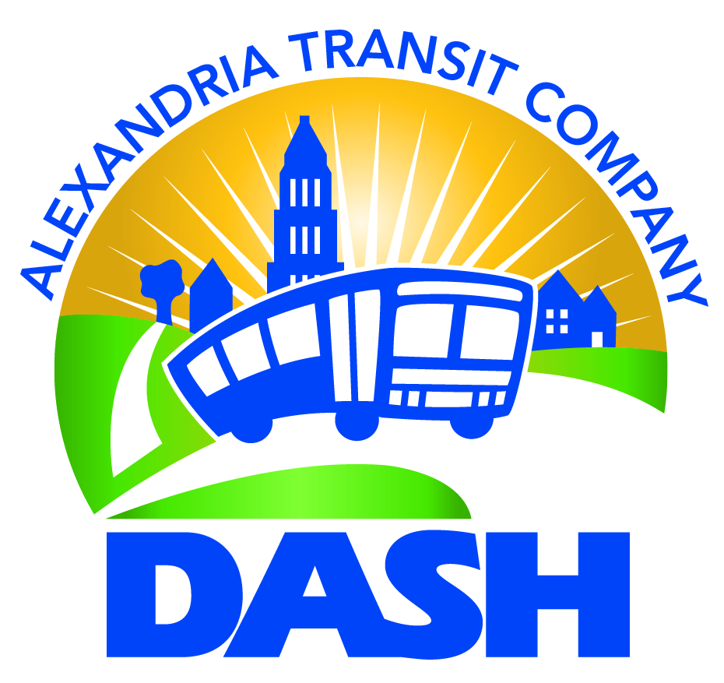
Partners
in Public Transit
Agenda Item: 7a
Board Packet Page: N/A
Board Action: FYI
November 2022
30

Slide 31
A Brief History
Virginia Transit Liability Pool – enabled by the Virginia General Assembly to provide public transit with a group, self-insurance mechanism.
Transit agencies pool their resources to group self-insure and have independence from the commercial insurance market
The pool is member-owned and member-run.
DRPT provided start-up capital
ATC founding member of VTLP under GM Bill Hurd
31
Notes:
Political subdivisions of the Commonwealth of Virginia, or agencies thereof, which operate public transit systems.

Slide 32
Virginia Transit Liability Pool
Coverage
  Liability coverage which provides protection in the event of third-party claims against DASH for bodily injury or property damage, and
  Fleet physical damage coverage with protection against hazards such as collision, fire, flood, wind and vandalism.
Limits of Coverage
  Offer high limits – why?
  Buses covered subject to deductible – lot and specific coverage
32

Slide 33
Claims
In the event of a claim the pool works with transit agency to complete a thorough investigation
  Statements
  Photos and videos
  Police report, fire report
  Witnesses, Engineers and Experts
Make liability determination - Contributory negligence
Litigation management
33

Slide 34
Loss Control
The optimal outcome is for no claims to occur, which is the goal for all concerned.
Safety Culture – shared values and beliefs – “how we do things around here”
  CEO is the leader of the organization for Safety Culture
  Safety message persistently presented and repeated – not just at safety meetings
  Safety is everyone’s responsibility, both management and employees are committed to it.
Lagging indicators – claim analysis
Leading indicators – frequency
Root Cause Analysis – “the most effective way to mitigate risk is to design it out”
34
Notes:
FTA will require adoption of a SMS (safety management system) by 2020.
VTLP is sponsoring TSI training on SMS this March, which will be hosted at DASH.
Lagging Indicators – such as claims frequency, rash of smaller accidents or incidents
Leading Indicators
Public Transit generally falls short of aviation in this area, and there are no common measures that could be used to benchmark across the industry.
Possible ideas – signal violations, hard brakes, speed violations, customer complaints, traffic tickets, near miss’, hours of training per driver,
Root Cause - a factor that caused an accident and which, if permanently eliminated through organizational or process improvement will prevent recurrences of this type of accident.

Slide 35
Risk Management Programs and Services
Site safety reviews
Safety Scorecard
Training seminars and workshops
TSI/NTI training
VTLP training
Ride-alongs
Attend safety meetings
Quarterly risk profile reports
New technology and products, research, newsletter
Collaboration with the DASH safety program
35

Slide 36
Partnership
Moving People Safely
Transit Users
DASH
VTLP
36
Notes:
GEM’s mission is to be a long-teDdiverrisk financing partner
to its member
public entities.
Diverging interests in some ways:
But all have one thing in common – we want to move people safetly

Slide 37
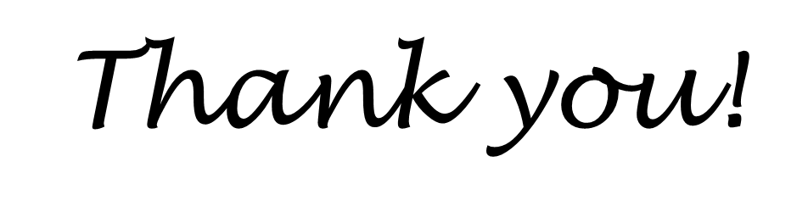
37

Slide 38
Consideration of Executive Session to discuss Legal Matters
Next ATC Board of Directors Meeting: December 14, 2022 @ 5:30pm
All Board Members
Motion Required: “I ________ (name) hereby move that the Alexandria Transit Company Board of Directors convene an Executive Session for the Purpose of Discussing Legal Matters, pursuant to Section 2.2-3711 (A1) of the Code of Virginia.”
Agenda Item:7b
Board Packet Page: 26
Board Action: Motion

Slide 39
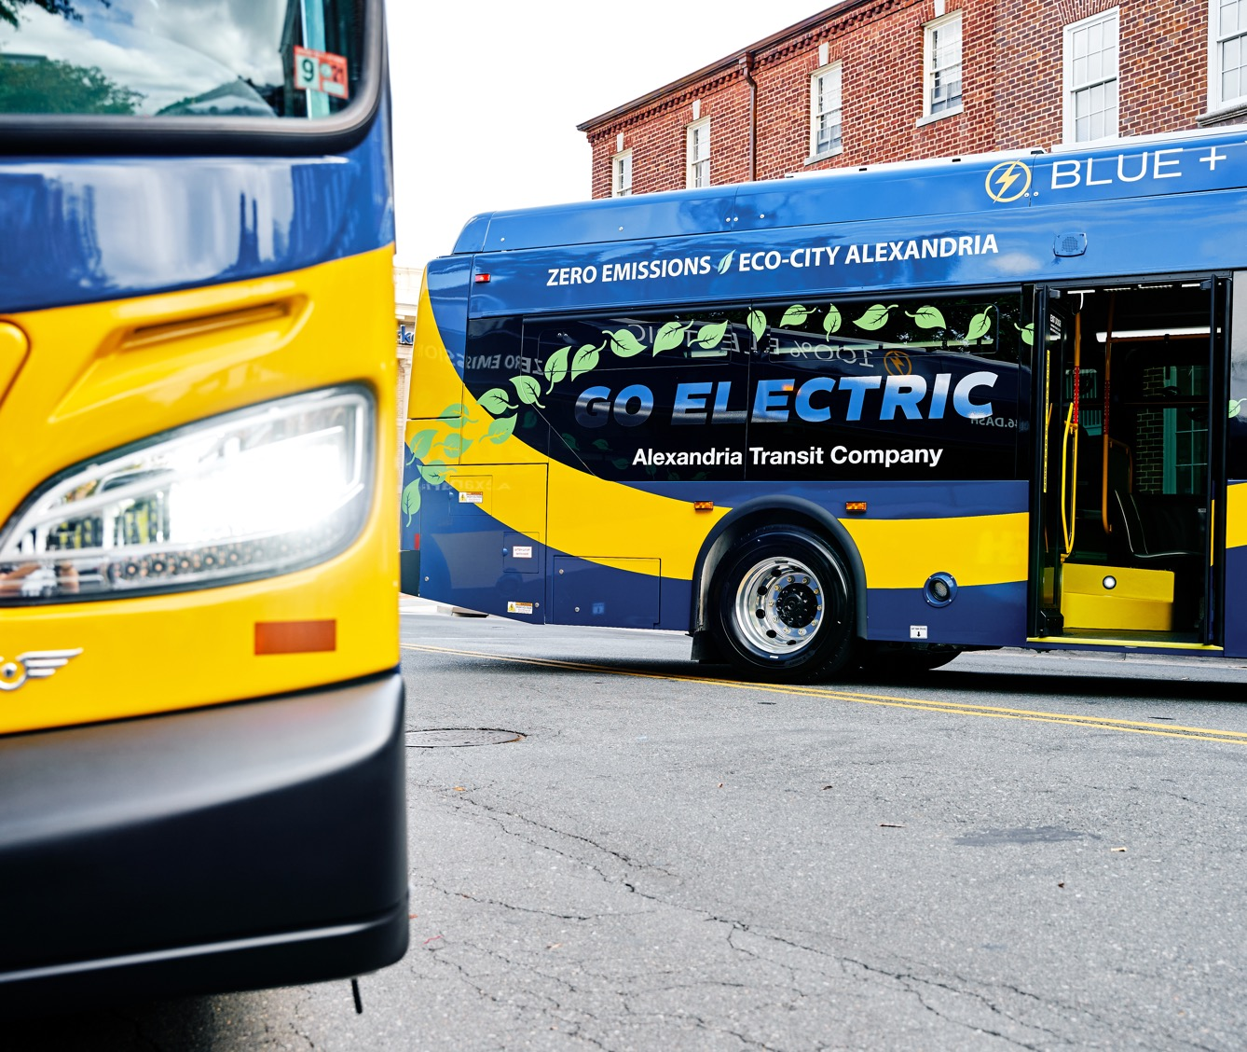
Next public meeting:
December 14, 2022
5:30pm
Agenda Item: 7
Board Packet Page: 20
The Board is in
EXECUTIVE SESSION

Slide 40
Reconvene Public Session &
Certification of executive session
Motion Required: “I ________ (name) hereby move to reconvene the public meeting of the Alexandria Transit Company Board of Directors.”
Motion Required: “I ________ (name) hereby move to certify that during the Executive Session of the Alexandria Transit Company Board of Directors, only those matters specified in convening the session were discussed, pursuant to Section 2.2-3711 (A1) of the Code of Virginia.”
Agenda Item:7b
Board Packet Page: 26
Board Action: Motion

Slide 41
Wrap-Up & Consideration of Adjournment
Next ATC Board of Directors Meeting: November 9, 2022 @ 5:30pm
Agenda Item:7b
Board Packet Page: 26
Board Action: Motion

Slide 42
Next meeting
December 14, 2022
5:30pm
The board meeting has concluded

