Slide 1
Alexandria Transit Company
Annual stockholders meeting
March 12, 2024

Slide 2
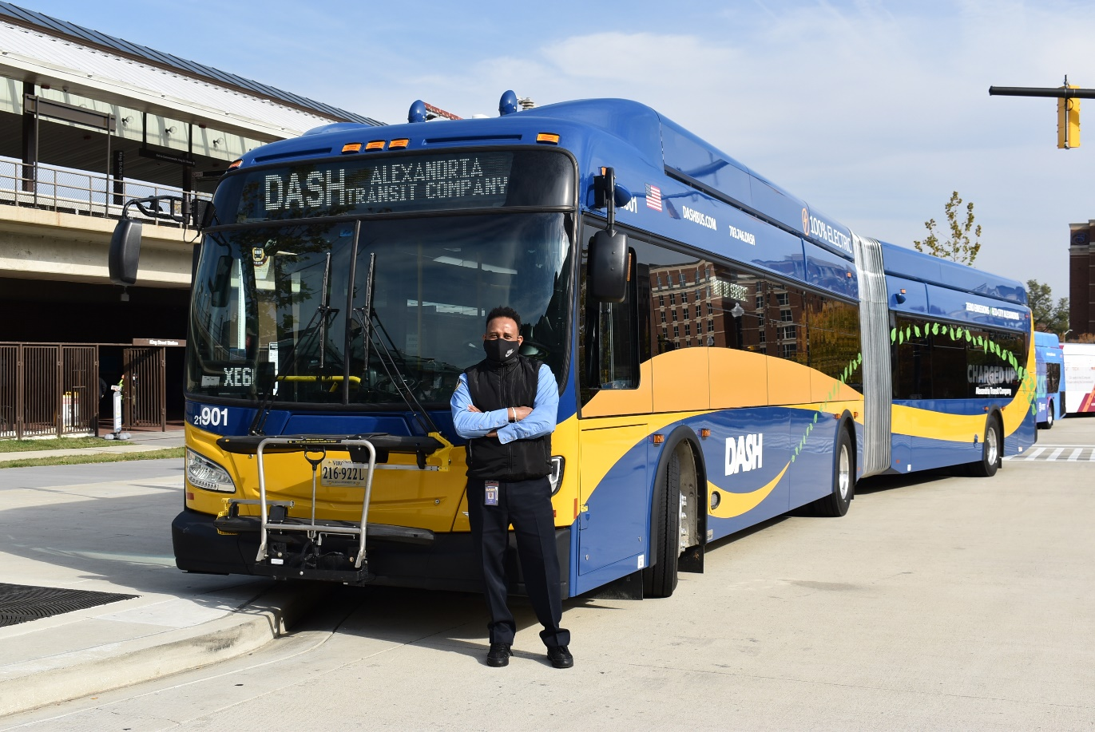
Meeting agenda
Call to Order
Item #1 – Chairs Welcome and Remarks
Item #2 – Slate of Directors
Item #3 – By-Laws Amendment
Item #4 – Outside Auditor
Item #5 – Other Business
Item #6 – Adjournment

Slide 3
Meeting agenda
Item #2 – Slate of Directors
Consideration of Approval:
David Kaplan
Stephen Klejst
Matt Harris
Ajashu Thomas
Jesse O’Connell
Kursten Phelps (New)
Praveen Kathpal (New)
Arish Gajjar (New)
Arthur Wicks (City Manager Designee)
Kendel Taylor (City Finance Designee)
Hillary Orr (City T&ES designee)

Slide 4
Meeting agenda
Item #3 – By-Laws Amendment Consideration of Approval:
Article I, Section 1
Section 1 - Annual Meeting. The annual meeting of the stockholders of the corporation shall be held in February on a date in the first three months of each calendar year of each year on a day as determined by the Chairperson of the Board of Directors in consultation with the City Manager of the City of Alexandria. (Amended 1/8/85)

Slide 5
Meeting agenda
Item #4 – Outside Auditor Consideration of Approval:
By agreement with the City of Alexandria, ATC accounts are maintained by the City’s Department of Finance and are audited as a part of the City’s annual audit. If the City’s outside auditor is also ATC’s outside auditor, the ATC audit can be done without duplication of effort or cost.
It is therefore recommended that the City’s outside auditor be designated ATC’s outside auditor.

Slide 6
Meeting agenda
Item #5 – Other Business Any other business as shall be brought forth by the Stockholders.
Item #6 – Adjournment
Consideration of adjournment of the Annual Stockholders Meeting of the Alexandria Transit Company.
Next annual meeting: Winter 2025 (exact date TBA)

