Slide 1

DAC Q3 MEETING AGENDA
Thursday, July 30, 2026 | 5:30 PM – 7:30 PM
01
06
Marketing & Public Engmt. Updates
Welcome & Introductions
02
Roll Call
07
Ambassadorship & Stakeholder Working Sess.
03
Meeting Mins. Approval
08
Additional Business
04
Information / Infotainment Display Demo & Q&A
09
Adjournment
05
Subcommittee Reports

Slide 2
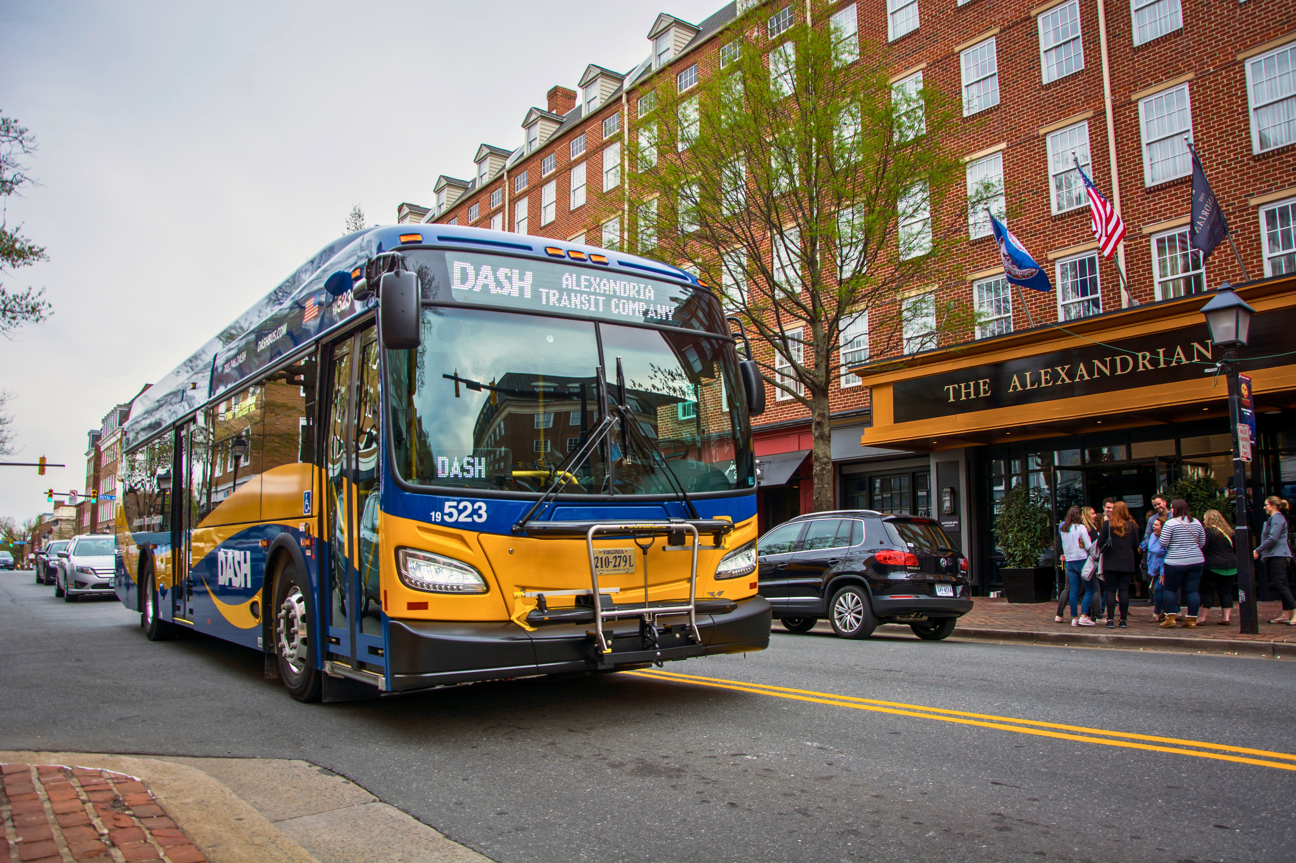
WELCOME
Nathaniel Cartagena | DAC Chair

Slide 3
ROLL CALL
Camila Olivares | Director of Marketing & Public Engagement & Committee Liaison

Slide 4
MEETING MINUTES APPROVAL
Nathaniel Cartagena | DAC Chair

Slide 5
INFORMATION / INFOTAINMENT DISPLAY DEMO & Q&A
Trevor Logan | Info. Tech. Systems Lead

Slide 6
MEMBERSHIP & RECRUITMENT SUBCOMMITTEE
Marcos Bernier, Jimmy Palmer, Nathaniel Cartagena, Payton Brown

Slide 7
ADVOCACY & PUBLIC POLICY SUBCOMMITTEE
Bonnie O'Day, Jim Durham, Marcos Bernier, Jacob Yoseph, Calvin O’Brien, Yvette Jiang, Payton Brown, Brendan Kiviat

Slide 8
EVENTS & PUBLIC ENGMT. SUBCOMMITTEE
Yvette Jiang, Payton Brown, Jim Maslanka,
Matthew McManus, Jimmy Palmer

Slide 9
RIDER EXPERIENCE
SUBCOMMITTEE
Erick Adams, Nathaniel Cartagena, Jason Kunik,
Nawfal Kulam, Eric Van Horn

Slide 10
MARKETING & PUBLIC ENGMT. UPDATES
Camila Olivares | Director of Marketing & Public Engagement & Committee Liaison

Slide 11
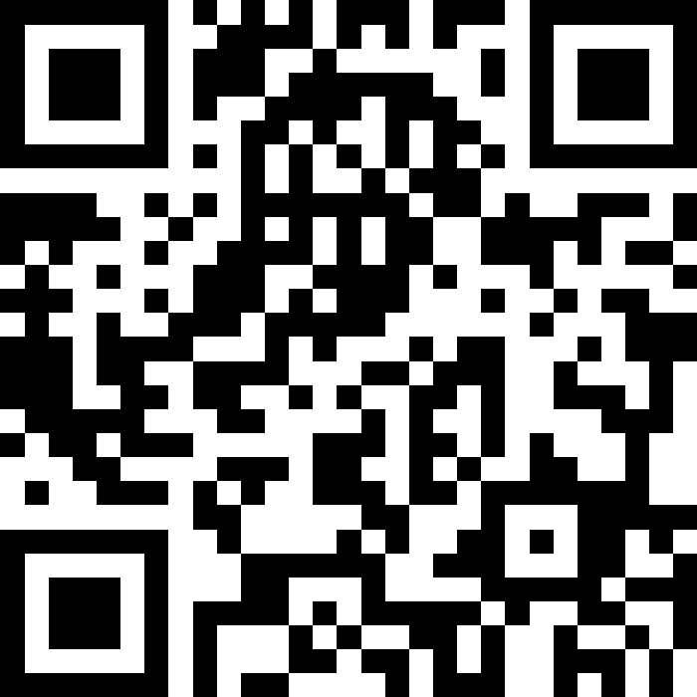
NOVA Consolidation Study

Slide 12
FY 2027 PRIORITIES
Understanding rider information needs and optimizing communication channels:
    Gather Rider Feedback: Determine how riders currently receive information, identify the types of information they need, and understand their preferred communication methods.
    Evaluate Existing Resources: Assess current communication channels and materials to pinpoint gaps and opportunity areas based on direct rider insights.
    Implement Changes: Update content and roll out improvements to align directly with identified rider needs.
Key Assets:
    Communication Materials: Ride Guide, Pocket Guide, Code of Conduct, and Bus Decals
    Communication Channels: Website, Social Media, Feedback Form, and Customer Service

Slide 13
UPCOMING EVENTS
Tuesday, August 4: Carlyle Commuter Fair + National Night Out
Thursday, August 13: ALX Youth Leadership Conference Networking Session
Wednesday, August 19: VT 2026 Transit Fair
Sunday, October 18: DASH Roadeo

Slide 14
AMBASSADORSHIP & STAKEHOLDER WORK SESS.
Nathaniel Cartagena | DAC Chair

Slide 15
Expanding Impact
The Concept – Community Amplification
Committee members tap into personal and professional circles (e.g., schools, community organizations, HOAs, friends) to spread transit updates and surveys directly to transit users.
Discussion –Appropriateness & Boundaries
How do we balance grassroots outreach with the appropriateness (e.g., not misusing DASH staff/resources, concerns from other groups)? How can we distinguish proper connectivity between DAC and others?
Ensuring Ethical & Inclusive Engagement
Ensuring all outreach remains helpful, non-partisan, and focused on connecting riders to DASH for everyone’s benefit, including the ability for continuous improvement.

Slide 16
Engagement Framework
1. Share & Inform
Amplify official messaging, major service reroutes, survey links, and upcoming public hearing dates to local community channels, neighborhood forums, and professional lists.
2. Listen & Gather
Act as active sensory nodes. Gather grassroots feedback, rider pain points, and unaddressed route needs from diverse community groups to bring back to committee meetings.
3. Connect & Champion
Build direct bridges between transit staff and local community leaders, school districts, major employers, and accessibility advocacy organizations.

Slide 17
Discussion
Framing The Approach
Next Steps & Intake
•
Comfort Level: What types of outreach do members feel comfortable undertaking as committee representatives?
•
Network Mapping: Let’s identify key sectors or groups each member can easily reach. We can build a survey, if neded.
•
Support Needed: What official toolkits or social templates do you need from transit staff to feel confident?
•
Opt-In Roles: Select an outreach path (e.g., Digital Ambassador, Event Liaison, or Feedback Collector).
•
Boundary Lines: What activities fall outside our purpose or cross into inappropriate advocacy?
•
Reporting Back: Establish a 10-minute standing item at committee meetings to share community network insights.

Slide 18
ADDITIONAL BUSINESS & ADJOURNMENT
Nathaniel Cartagena | DAC Chair

